Slide 1
Sparse Distributed Representation Trumps Machine Parallelism for Improving Computational Efficiency
Rod Rinkus
Neurithmic Systems
Neuro-Inspired Computational Elements (NICE) Workshop
Berkeley, CA
Mar. 7, 2016

Slide 2
Machine Parallelism
P
M
Whole Problem
P
M
Whole Answer
P
M
P
M
P
M
P
M
P
M
P
M
Note: The technique of shared (tied) parameters (underlying computing average gradients), essential to making ConvNet learning tractable, intrinsically introduces the need for moving large amounts of data.
Machine parallelism per se induces the need for moving data, not just between the processor and memory of any single node, but between nodes, or in other words over macroscopic distances.

Slide 3
Sparse Distributed Representation vs. Localist Representation
Distributed Representation
Localist Representation
Each represented item is represented by a set of coactive units.
Every representational unit participates in the representations of multiple items.
Each represented item is represented by a unique unit.
A Single algorithmic step (atomic operation) updates the state of only one represented item
A Single atomic operation updates the states of more than one represented item
Localist Representation
4
7
2
8
4
5
NOTE: Sparse distributed representations ≠ Sparse Coding concept (Olshausen & Field, 1996)
Atomic operation = “+1”
4
7
2
9
4
5

Slide 4
Sparse Distributed Representation (SDR)
The number of unique codes = 3⁶ = 729
Intersections with φ(A)
0
1
2
0
1
2
0
1
2
0
1
2
0
1
2
0
1
2
0
1
2
0
1
2
0
1
2
0
1
2
0
1
2
0
1
2
0
1
2
0
1
2
0
1
2
0
1
2
0
1
2
0
1
2
SDR coding field
0
1
2
0
1
2
0
1
2
0
1
2
0
1
2
0
1
2
Input A
0
1
2
3
4
5
6
7
8
9
10
11
A single atomic operation updates the states of multiple represented (stored) items
E.g., changing the state of the representational unit 0 in CM 1, changes states of all four stored items
For such a scheme to work, the process that maps inputs to SDR codes must enforce that similar inputs map to similar (more highly intersecting) codes.

Slide 5
SDR Requires Fewer Operations to Update States of All Stored Items
The number of unique codes = 3⁶ = 729
The number of steps needed to update all the items remains constant as items are added.
If you want the localist field to store one more item, it requires one more unit and 12 more weights
The time it takes now to update all the items has increased
0
1
2
0
1
2
0
1
2
0
1
2
0
1
2
0
1
2
0
1
2
0
1
2
0
1
2
0
1
2
0
1
2
0
1
2
0
1
2
0
1
2
0
1
2
0
1
2
0
1
2
0
1
2
0
1
2
0
1
2
0
1
2
0
1
2
0
1
2
0
1
2
0
1
2
3
4
5
6
7
8
9
10
11
12
13
14
15
16
17
18
0
1
2
3
4
5
6
7
8
9
10
11
0
1
2
3
4
5
6
7
8
9
10
11

Slide 6
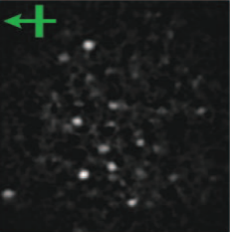
Neural/Cortical Interpretation of Sparsey®?
Ohki, e al (2015) Reid lab, mouse V1
Minicolumn = CM is a WTA module
A mac code is a set of ~70 active L2/3 pyramidals
Turn on and off as a unit
Mac codes are SDRs
The mac code space is 20⁷⁰
The L2/3 SDRs are the contents of thought
Described in Thesis (1996), many papers since then, e.g., Frontiers in Neuroscience papers, 2010, 2014.
Macrocolumn (“Mac”)
Tangential View
Competitive module (CM) = Minicolumn
2/3
4A
4B,C
5A
5B
6
30 μm
300 μm

Slide 7
Neural/Cortical Interpretation of Sparsey®?
Ohki, e al (20015) Reid lab, mouse V1
Minicolumn = CM is a WTA module
A mac code is a set of ~70 active L2/3 pyramidals
Turn on and off as a unit
Mac codes are SDRs
The mac code space is 20⁷⁰
The L2/3 SDRs are the contents of thought
Macrocolumn (“Mac”)
Tangential View
Competitive module (CM) = Minicolumn
CM
Mac
0
1
2
3
0
1
2
3
0
1
2
3
0
1
2
3
0
1
2
3
0
1
2
3
ψ
2/3
Max
Max
Max
Max
Max
Max
V
4A
4B,C
Average (G)
5A
5B
Input
(Thalamus)
Activation Function Modulation
6
0
1
2
3
4
5
6
7
8
9
10
11
Code Selection Algorithm (CSA) involves two rounds of competition per execution (proposed to execute in a gamma cycle)
Sub-cortical, involving neuromod’s (NE, Ach, etc.)
30 μm
300 μm

Slide 8
Results of Research
2013-2016, supported under DARPA UPSIDE
Results:
Best result so far:
67% recognition accuracy on Weizmann (chance = 10%)
learned in 3.5 minutes on single CPU (no machine parallelism).
Only organization that has reported results of a model based on sparse distributed representations on a benchmark video recognition problem…Weizmann
Only organization with published results of operational hierarchical SDR models

Slide 9
Results of Research
2013-2016, supported under DARPA UPSIDE
Results:
Best result so far:
67% recognition accuracy on Weizmann (chance = 10%)
learned in 3.5 minutes on single CPU (no machine parallelism).
We have gained a lot of knowledge about how to build:
modular,
multi-level networks,
that do single-trial, on-line learning
and best-spatiotemporal-match retrieval
of sequences (streaming data),
without computing gradients or generating samples to drive learning
where learning and retrieval time remains constant as the number of stored sequences increases
54 Macs
216 Macs
We are currently engaged in human-in-loop (hyper)parameter tuning to improve accuracy and extend to other video recognition benchmarks.

Slide 10
Details of Classification Experiment
Classification is based on total activation pattern in top level at end of sequence
Those patterns are used as inputs to SVM
Leave-one-out training, augmentation

Slide 11
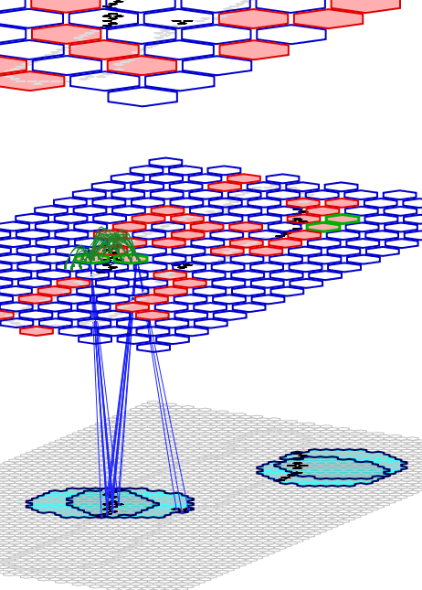
Visualizing Continually Updated Likelihood Distributions
Three Weizmann snippets learned in this run, total of 40 frames.
RFs of neighboring macs overlap
15 SDRs stored in L2 mac 23 during learning.
Likelihoods of those 15 codes, i.e., of the spatiotemporal moments they encode
30 SDRs stored in L1 mac 91 during learning.
Receptive Field of L2 mac 23 consists of 25 L1 macs
Likelihoods of those 30 codes (moments)
Receptive Field of L1 mac 91 consists of 102 pixels

Slide 12
Showing the Stored Spatiotemporal “Moments”
The L2 moments have twice the time constant
Pictures of the actual spatiotemporal moments

Slide 13
Summary
Sparse Distributed Representations allow fixed learning (storing) of new items, retrieval of spatiotemporally best-matching item from memory, and belief update as the number of stored items grows.
Machine parallelism introduces the need to move data and thus increases power use
SDR (algorithmic parallelism) is more important than machine parallelism for making computation faster and more power efficient
First reported results of SDR applied to benchmark video event recognition, and of hierarchical SDR. (Weizmann)

